Slide 1

Inheritance and Polymorphism

Slide 2
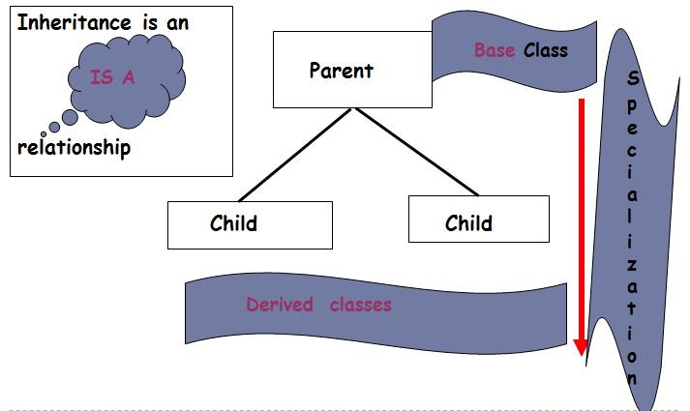
Inheritance-Code re-use

Slide 3
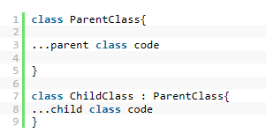
INHERITANCE
Key feature of OOP
Common features – base class
Specialised features – derived classes
Derived classes inherit standard behaviour
Derived classes can OVERRIDE (replace) features inherited from the base class

Slide 4
Example: Account – BASE CLASS
A base class needs to contain all common data values
Change the access specifier for every data value to Protected (replace Private). This enables the derived class to use these variables directly (the variables becomes visible in the derived class) --WARNING
All public and protected variables and methods are inherited with the exception of the constructor.
Therefore each derived class must define its own constructor (constructors are not inheritable). base class MUST contain at least ONE default CONSTRUCTOR.
Account:
AccountHolder
AccountNumber
Balance
Deposit ()
WithDrawal ()
Display()
Constructor √√
Savings Account
Cheque Account

Slide 5
Polymorphism
Polymorphism - means "many-shaped“, one name many forms. "Many forms of a single object is called Polymorphism."
For example:
one object behaving as multiple forms
One function behaves in different forms.
Your mobile phone, one name but many forms:
As phone
As camera
As mp3 player
As radio
Person behaves as a SON in house, at the same time that person behaves like an EMPLOYEE in the office.

Slide 6
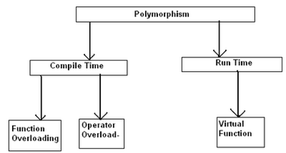
Polymorphism
Types of polymorphism

Slide 7
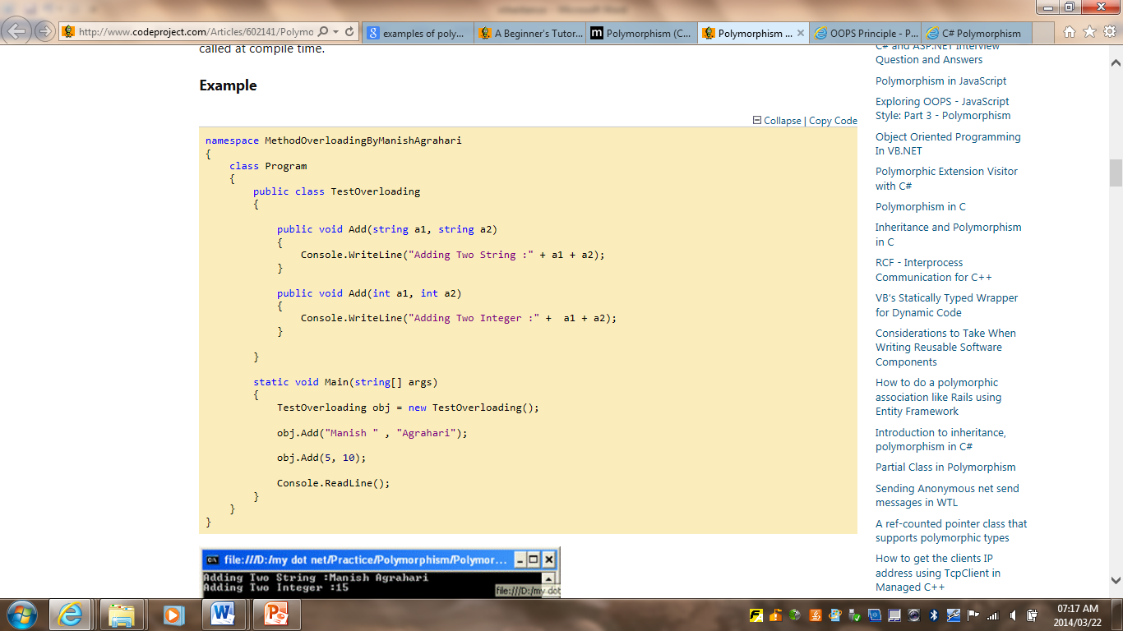
Polymorphism - overloading
Same method name, with identical parameter # but different parameter data type
Method overloading!!!
One method behaving differently – depending on the data type in this instance
Notes:
In static polymorphism, the decision is made at compile time.
Which method is to be called is decided at compile-time only.
Method overloading is an example of this.
Compile time polymorphism is method overloading, where the compiler knows which overloaded method it is going to call.
Method overloading is a concept where a class can have more than one method with the same name and different parameters.
Compiler checks the type and number of parameters passed on to the method and decides which method to call at compile time and it will give an error if there are no methods that match the method signature of the method that is called at compile time.

Slide 8
Dynamic polymorphism
In this type of polymorphism methods have the same name, same signature but different in the implementation. In Dynamic polymorphism methods are overridden so it also called as method overriding.
During run time, Method overriding can be achieved by using inheritance principle and using "virtual" and "override" keyword. so this type of polymorphism can also be called as late binding.
In late binding compiler doesn't know what kind of methods it has to call and which can be achieved only during the run time.so it is called as run time polymorphism.

Slide 9
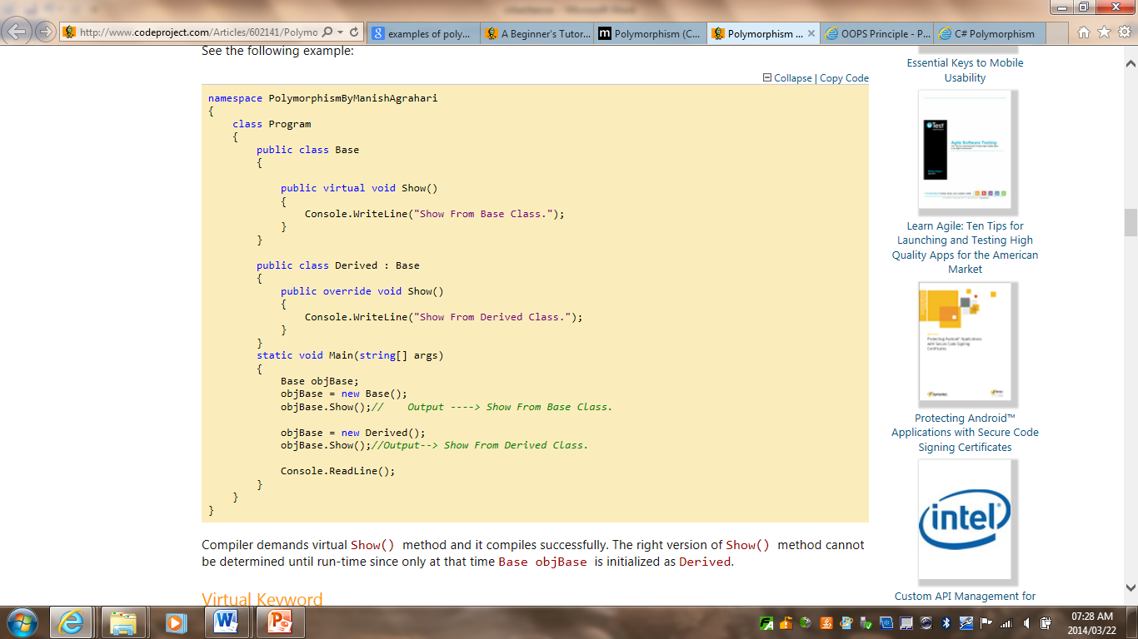
Polymorphism - overriding
Method overriding allows us to have methods in the base and derived classes with the same name and the same parameters.
Through the reference variable of a base class, the determination of the method to be called is based on the object being referred to by reference variable.
Notes:
Dynamic or Runtime Polymorphism
Run-time polymorphism is achieved by method overriding. Method overriding allows us to have methods in the base and derived classes with the same name and the same parameters. By runtime polymorphism, we can point to any derived class from the object of the base class at runtime that shows the ability of runtime binding.
Through the reference variable of a base class, the determination of the method to be called is based on the object being referred to by reference variable.
Compiler would not be aware whether the method is available for overriding the functionality or not. So compiler would not give any error at compile time. At runtime, it will be decided which method to call and if there is no method at runtime, it will give an error.

Slide 10
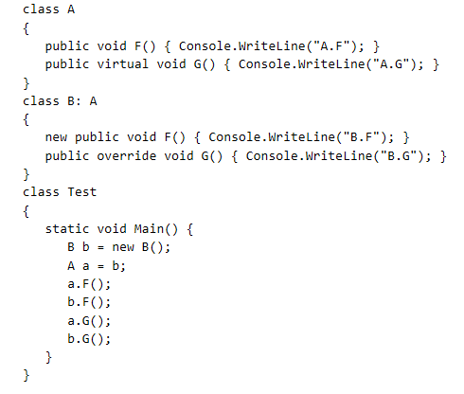
Virtual Method
For every virtual method declared in or inherited by a class, there exists a most derived implementation of the method with respect to that class.
The class B introduces a new non-virtual method F, thus hiding the inherited F, and also overrides the inherited method G.

Slide 11
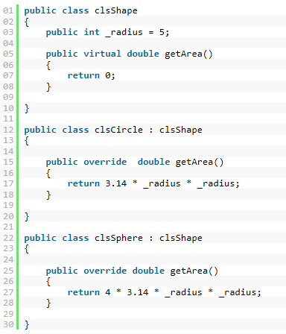
Polymorphism - overriding

Slide 12
Polymorphism
At run time, objects of a derived class may be treated as objects of a base class in places such as method parameters and collections or arrays. When this occurs, the object's declared type is no longer identical to its run-time type.
Base classes may define and implement virtual methods, and derived classes can override them, which means they provide their own definition and implementation. At run-time, when client code calls the method, the CLR looks up the run-time type of the object, and invokes that override of the virtual method. Thus in your source code you can call a method on a base class, and cause a derived class's version of the method to be executed.

Slide 13
Readings
Polymorphism (C# Programming Guide) http://msdn.microsoft.com/en-us/library/ms173152.aspx
Inheritance (C# Programming Guide) http://msdn.microsoft.com/en-us/library/ms173149.aspx

